Slide 1


Slide 2
AGENDA
Objective
Data Gathering
Insight
Conclusion

Slide 3
OBJECTIVE
To present a comprehensive analysis of the online course platform with a focus on enhancing learner accessibility, improving course engagement through interactive content, evaluating instructor performance and course effectiveness.
So in this we are majorly focus on below points:
To find out how does user engagement vary by device used.
Check the Month In which there are most Students Enrolled
Are learners spending enough time relative to the course duration, and how does this vary across different courses.
To find out which courses have the highest and lowest average completion rates, and what does this reveal about learner engagement across different subjects.

Slide 4
Data Gathering
The data has been acquired from online source in excel format gathered user activity data from the learning platform,
including:
Device type used
Enrollment dates
Course names and durations
Time spent on courses
Course completion rates
After that I cleaned the data, check the format and remove null values from it and also check the data type is it in correct form or not.
Then I load the data in power bi and started creating visualization.
I created interactive visuals such as bar charts, donut charts, and line graphs to explore:
Device-based engagement
Monthly enrollments
Time spent vs. course duration
Completion rate comparisons This made trends and anomalies easier to identify.
Raw Data Link:Online course.xml

Slide 5
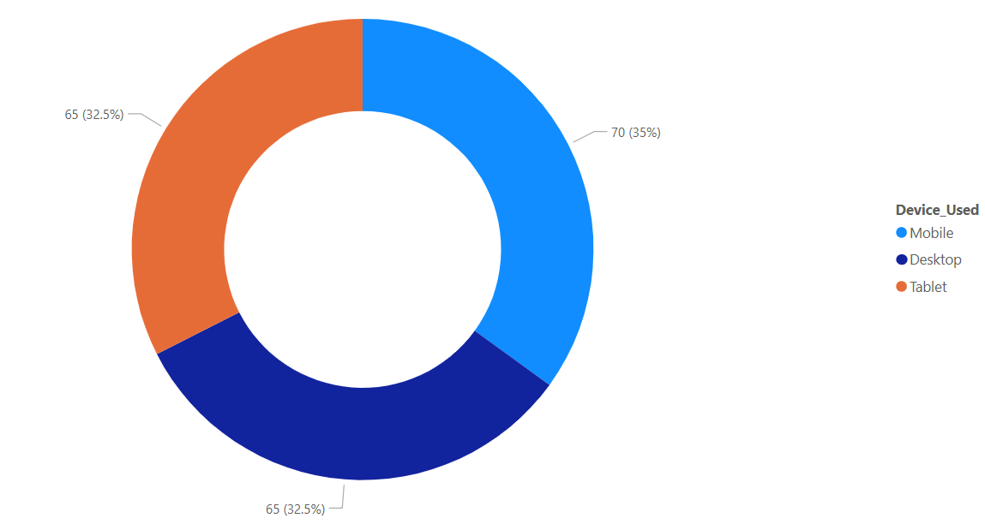
Insights: To find out how does user engagement vary by device used.
Mobile users demonstrate efficient learning behavior, completing more courses despite shorter or more frequent sessions.
This suggests that mobile learners are purpose-driven and benefit from the flexibility and accessibility of on-the-go learning.

Slide 6
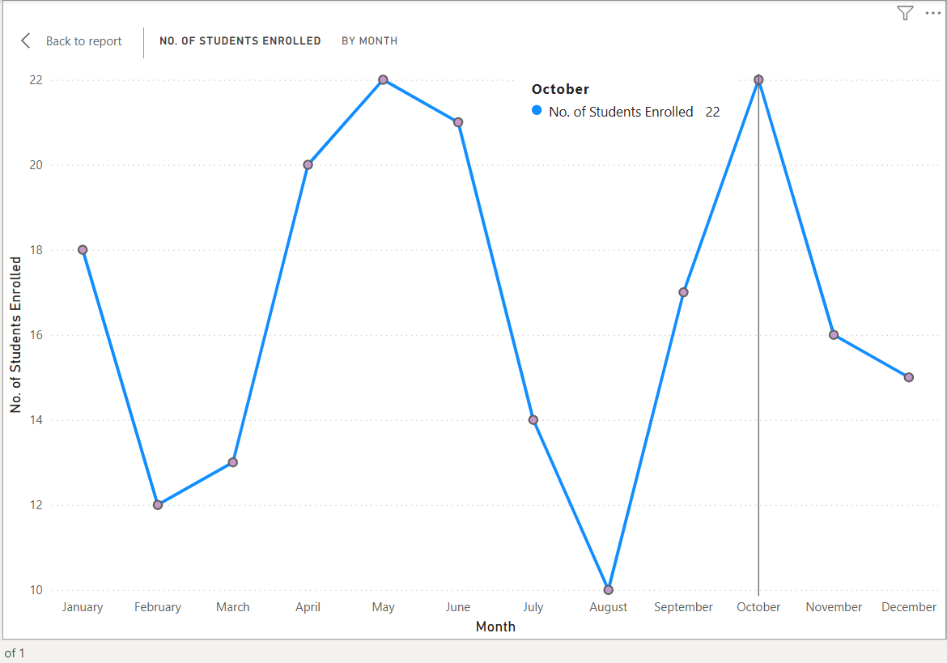
Insights: Check the Month In which there are most Students Enrolled.
Spikes in enrollment may occur in January (New Year resolutions),May-June (mid-year career shifts), or October (academic year alignments).
Drop-offs may appear in holiday-heavy months like August.

Slide 7
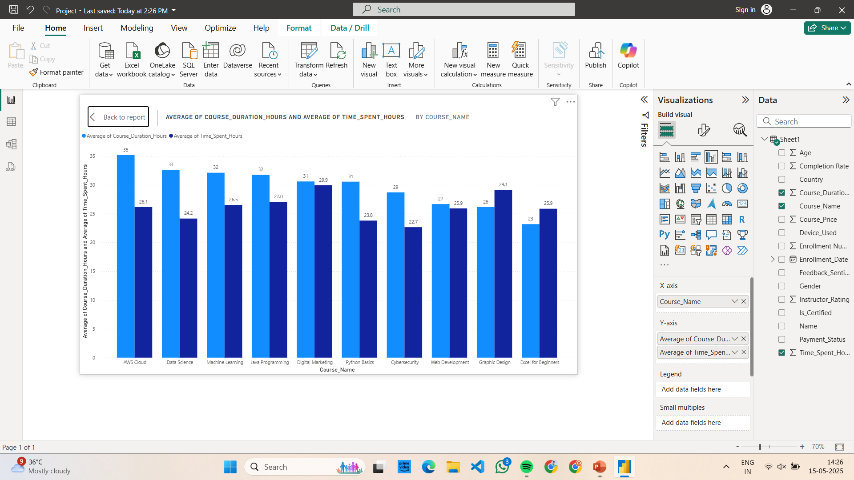
Insights : Are learners spending enough time relative to the course duration, and how does this vary across different courses.
Some long-duration courses like AWS Cloud,Data Science and Machine Learning may have lower average watch times, indicating poor engagement or content fatigue.
Shorter, interactive courses like Excel and Graphic Design see higher completion and engagement rates.

Slide 8
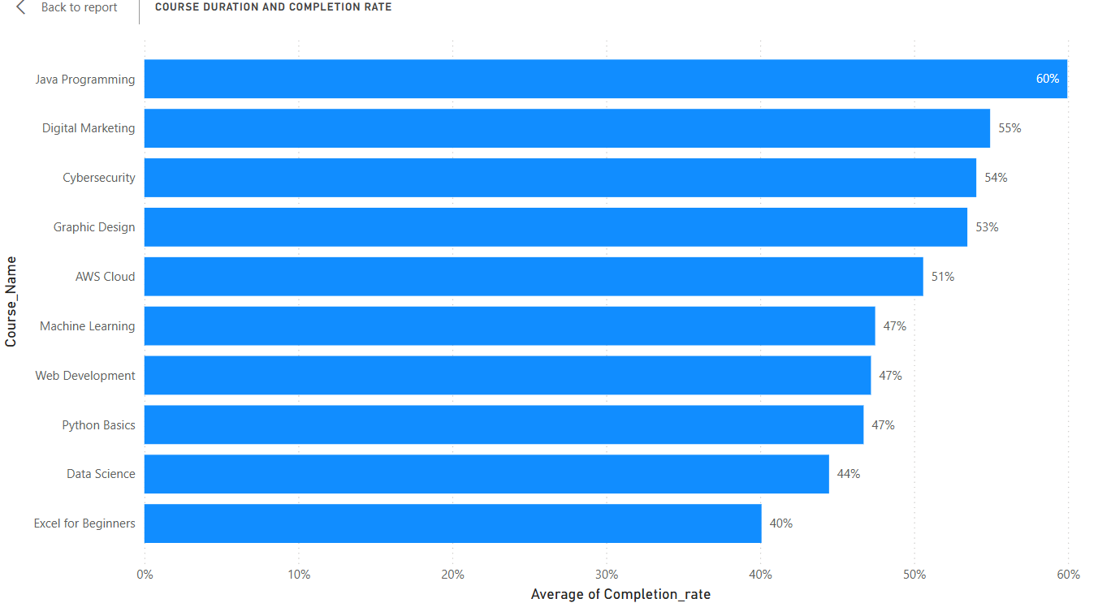
Insights : To find out which courses have the highest and lowest average completion rates.
High completion: Often in short-term or skill-based courses (e.g., Java , Digital Marketing).
Low completion: May occur in theory-heavy or long-term certifications like(Data Science and Python).

Slide 9
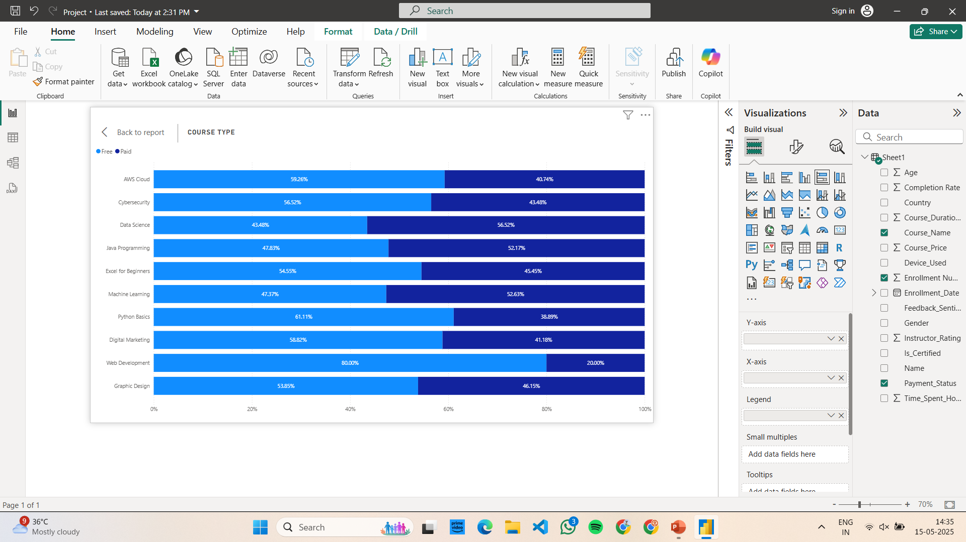
Insights : What percentage of users prefer free courses over paid ones.
A large portion of users likely prefer free courses, especially new users.
Paid courses might show higher completion due to the commitment involved.

Slide 10
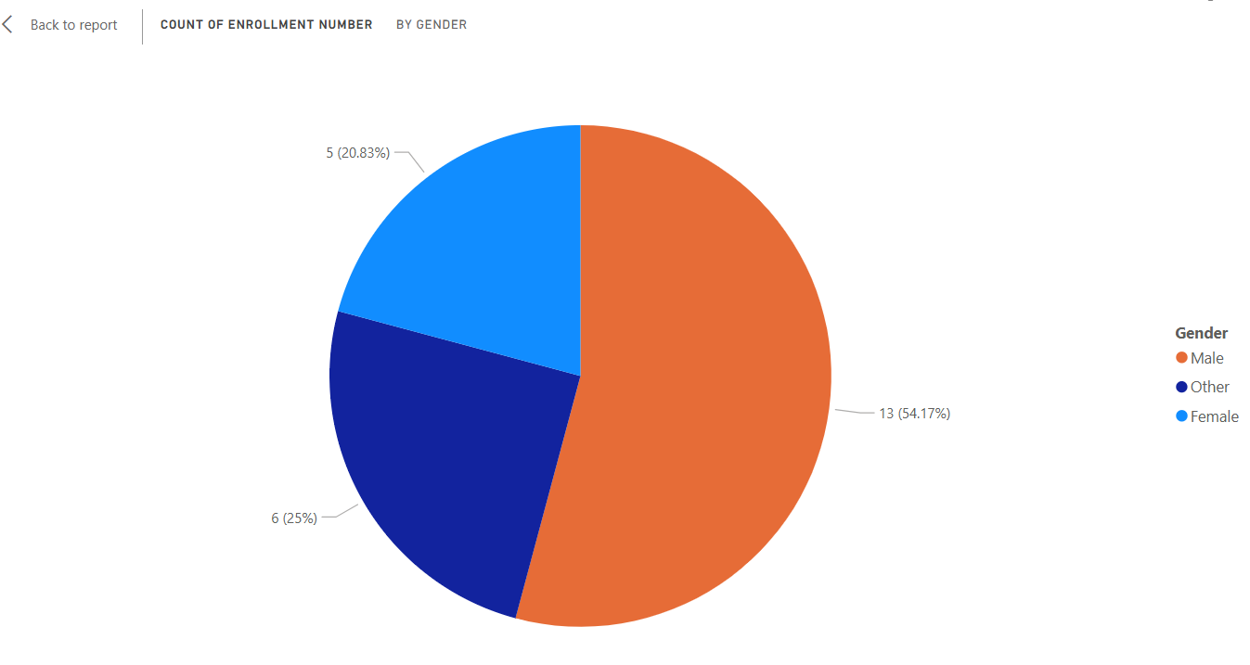
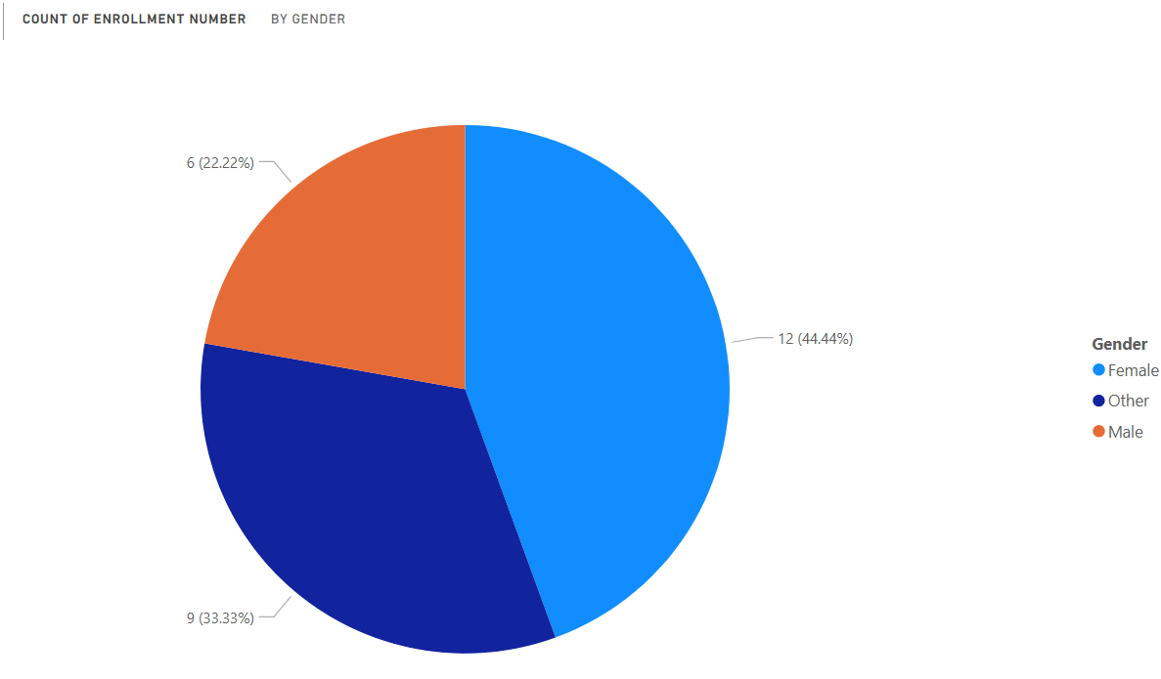
Insights : What percentage of users prefer free courses over paid ones.
Free
Paid
In India the data reveals that most male users prefer free courses, while a higher percentage of female users tend to enroll in paid courses.

Slide 11
Conclusion
1. How does user engagement vary by device used:The platform should further optimize the mobile learning experience, such as improving UI/UX for smaller screens and enabling offline access.Invest in mobile-first content design (short videos, micro-lessons, quizzes) to support and expand this highly engaged user base.
2. Which month has the most students enrolled: Marketing campaigns and course launches should be concentrated around peak enrollment months. Discounts or promotions can be tested during low-enrollment periods to balance traffic.
3. Which courses have the highest and lowest average completion rates : Use the structure of high-performing courses as a model. Provide support (e.g., progress tracking, peer forums) for courses with low completion.
4. What percentage of users prefer free courses over paid ones :Free courses are essential for user acquisition.Offering a few free modules or trials for paid courses could help convert free users into paying customers.

Slide 12
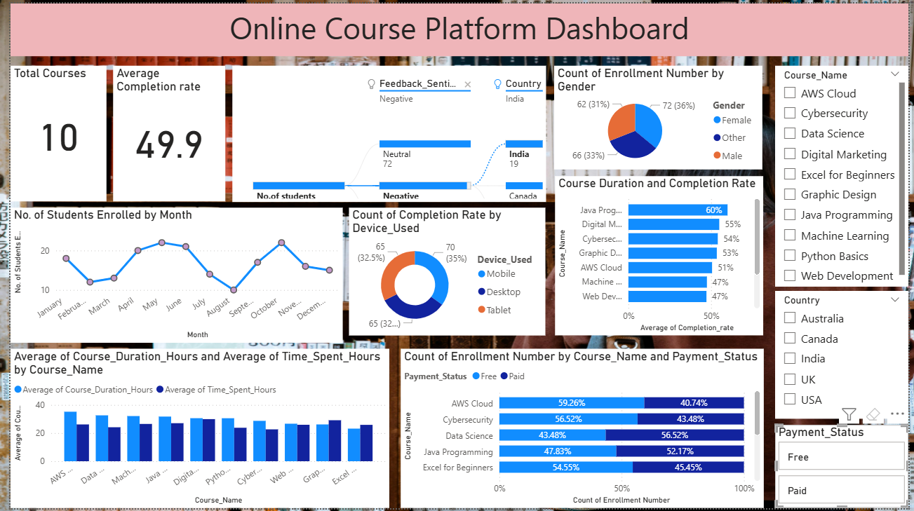
Final dashboard

Slide 13

THANK YOU

